Slide 1
What Factors Drive Energy Usage? Utilizing Objective and Subjective Data from Duke Energy 2010
A Project by Kent Bryant, Evan Johnson,
Kristen Mason, and Carly Osborne

Slide 2
The Quandary Continues:
Do household attitudes impact usage?
My household is conscientious about recycling things like bottles, cans, and paper – “greenness”
We pay close attention to how much electricity we use in our home – “conservation”
I want my cell phone to have a broad range of capabilities and applications – “techies/first adopters”
Does energy usage vary depending on…
Income?
Education?
Age?
Weather?
Household Size?
Geographic Location?

Slide 3
The Data
Primary Source: Duke Energy Progress Customer Data
Balanced, representative sample of Duke’s NC, SC, and FL markets
Detailed attitudinal and behavioral survey data
Metered electricity consumption
Zip Code Level Geographic Markers
Household and demographic characteristics
Other sources
US Census Bureau – geolocation by zip code
NOAA – historic weather data
Notes:
Google API map for additional geographic location data created from the US Census Bureau originally in 2000, updated over time (last updated in February of 2018).
The latitude and longitude given for each ZIP code is typically (though not always) the geographic centroid of the ZIP code; in any event, the location given can generally be expected to lie somewhere within the ZIP code's "boundaries".
NOAA historic weather data for 2010
Utilized closest weather stations to participants zip codes for annual temperature

Slide 4
Data Manipulation
Complete Case Analysis for Attitude Scales
Standardize variables – e.g. zip code transformations for consistency
Remove Null and “I don’t know” responses from analysis
Use zip codes to merge on lat./long. data (centroids)
Used nearest city (citipy) to merge on weather station data
Final sample size
N = 4069 households
N = 500 zip codes

Slide 5
Attitude Scales
Greenness – concern and conscientiousness around environment
Conservation – values and concerns about saving energy and related costs
Techies – those who are quick to try new technologies
All three are composite measures based on individual survey responses to Likert scale (1-10) agreement with the following statements :
Notes:
Talk about combining survey items to make scales

Slide 6
“greenness”
My household is conscientious about recycling things like bottles, cans, and paper
I believe reducing my household energy consumption is important in protecting the environment
I am willing to make significant changes in my lifestyle and habits to protect the environment for future generations
Climate change and global warming is real and it's important that we take actions to minimize it

Slide 7
“conservation”
I have done about as much as I can, within reason, to conserve on the use of electricity in my home
Everyone should make a real effort to conserve energy, even if they don’t have to worry about the cost
We pay close attention to how much electricity we use in our home

Slide 8
“first adopters”
I am likely to buy a plug-in electric hybrid car when a practical, affordable model is available from a major company
My household is usually one of the first to try new technologies when they come out
I want my cell phone to have a broad range of capabilities and applications

Slide 9
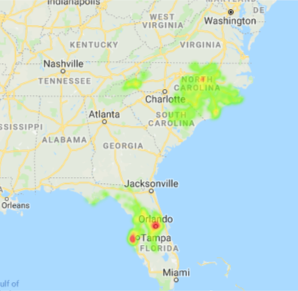
Figure 1

Slide 10
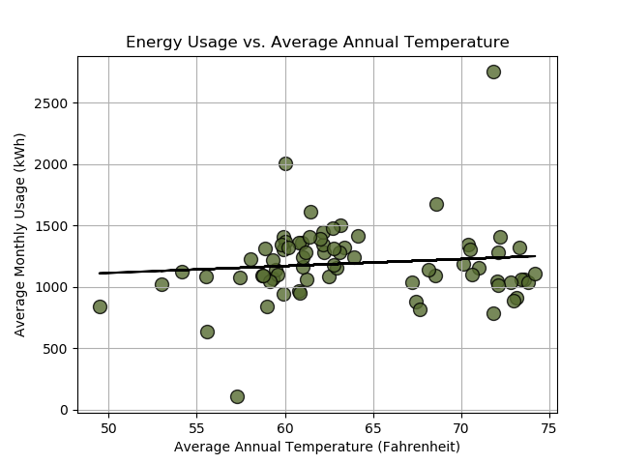
Figure 2

Slide 11
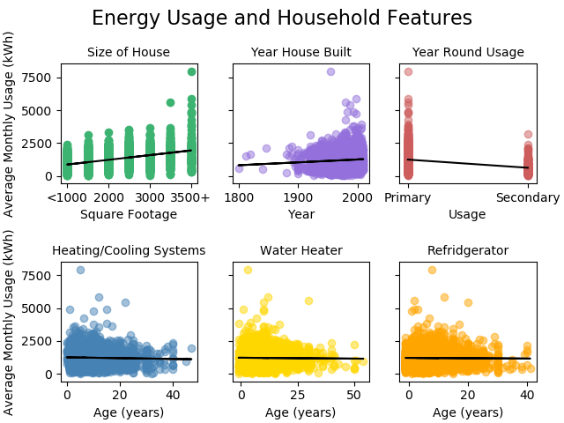
Figure 3

Slide 12
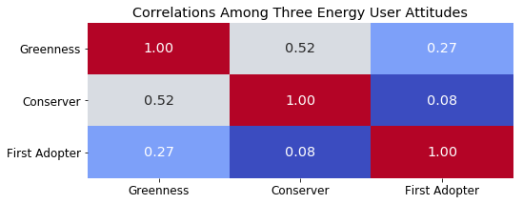
Figure 4 Relationships among attitude scales

Slide 13
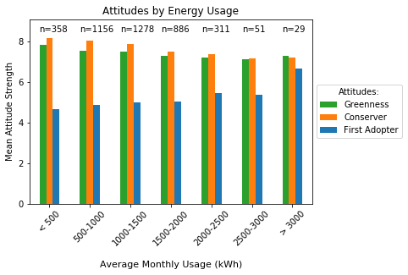
Figure 5

Slide 14
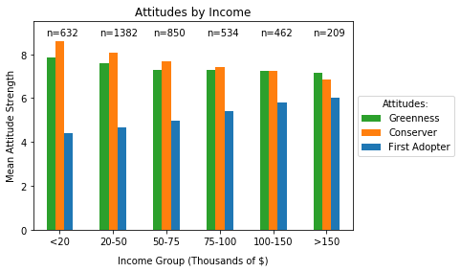
Figure 6

Slide 15
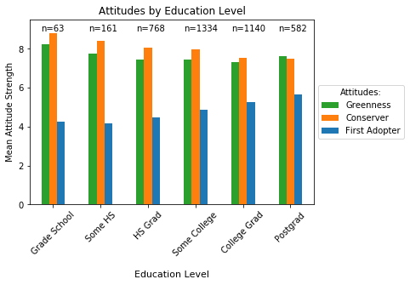
Figure 7

Slide 16
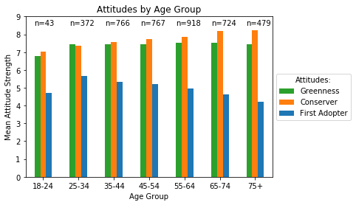
Figure 8

Slide 17
Limitations
2010 Data!
Attitudes have likely changed
Especially since recession and natural gas boom
Limited to those that use Duke Energy as their energy provider
Regionally limited to the Southeast and may not have the same relationships applied to other regions of the country

Slide 18
Take Home Message
Readiness to adopt new energy tech increases with energy consumption, income and education
Conservation and pro-environmental attitudes are higher among lower energy consumers, as well as less educated and lower income
Predictable positive relationships between energy use and housing size, temperature, and population density

Slide 19
So What???
We need to understand how to market energy efficiency and resource conservation products across demographic categories
This requires knowledge of which consumer groups are currently demonstrate high levels of readiness to adopt such products and strategies
We find that younger, higher income, well-educated and high consuming households show the most room for growth in pro-environmental, pro-conservation attitudes
This finding can help companies and government promote conservation of energy resources and sustainable energy behaviors

